Slide 1
Microsoft Azure Administration | Konfiguration | Monitoring
Modul 5 – Microsoft Azure| Azure Automation

Slide 2
Inhalte
Monitoring
01
Hands OnLab
03
Lab 5.1
Lab 5.2
Azure Automation
02

Slide 3
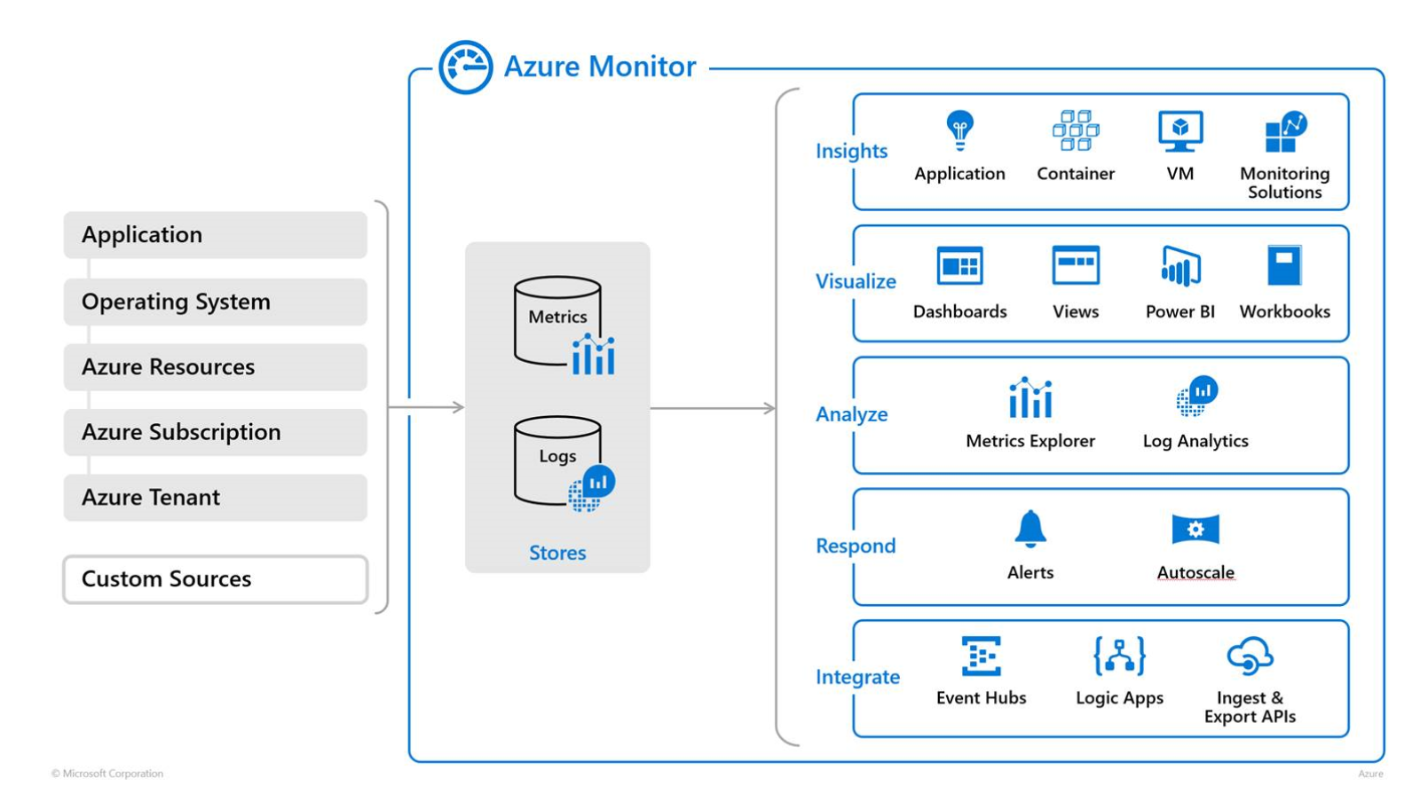
Azure Monitoring

Slide 4
DEMO: Monitoring mit Azure Monitor
Notes:
Portal
Powershell / CLI

Slide 5
Lab 5.1: Azure Monitoring
Notes:
Portal
Powershell / CLI

Slide 6
Azure Automation
Notes:
Portal
Powershell / CLI

Slide 7
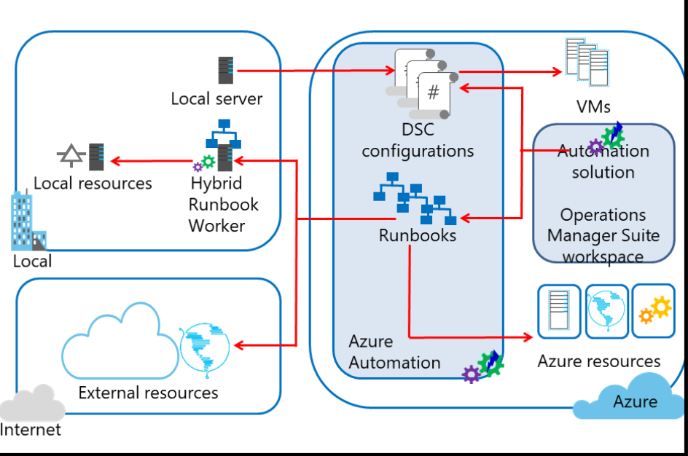
Azure Automation

Slide 8
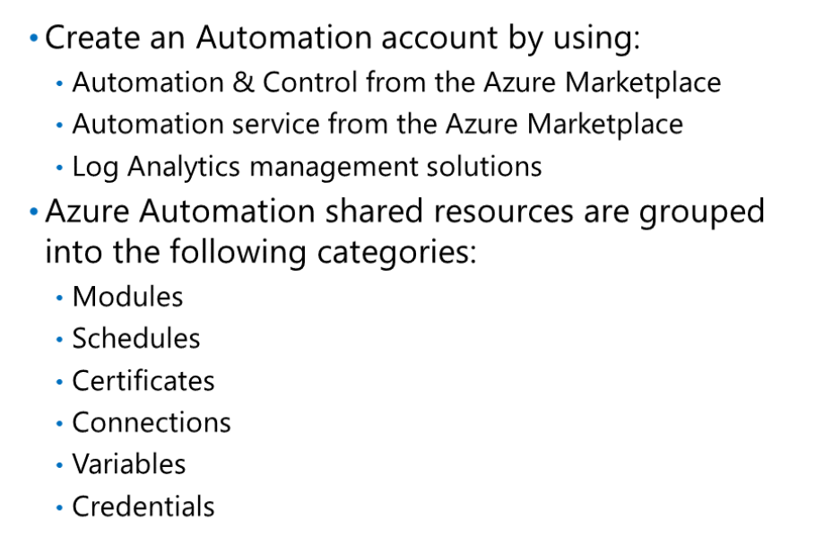
Azure Automation | Erstellung

Slide 9
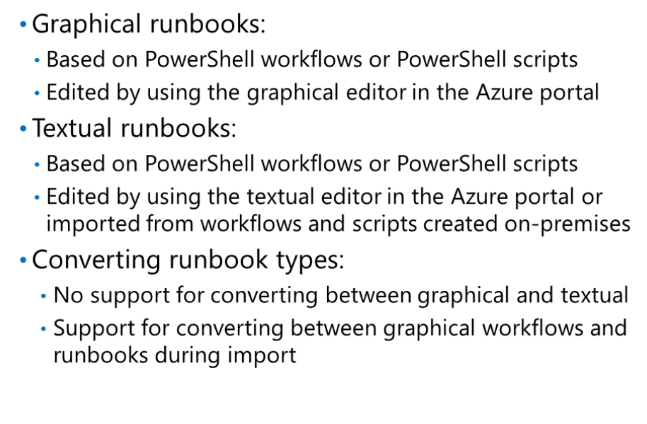
Azure Automation | Runbooks

Slide 10
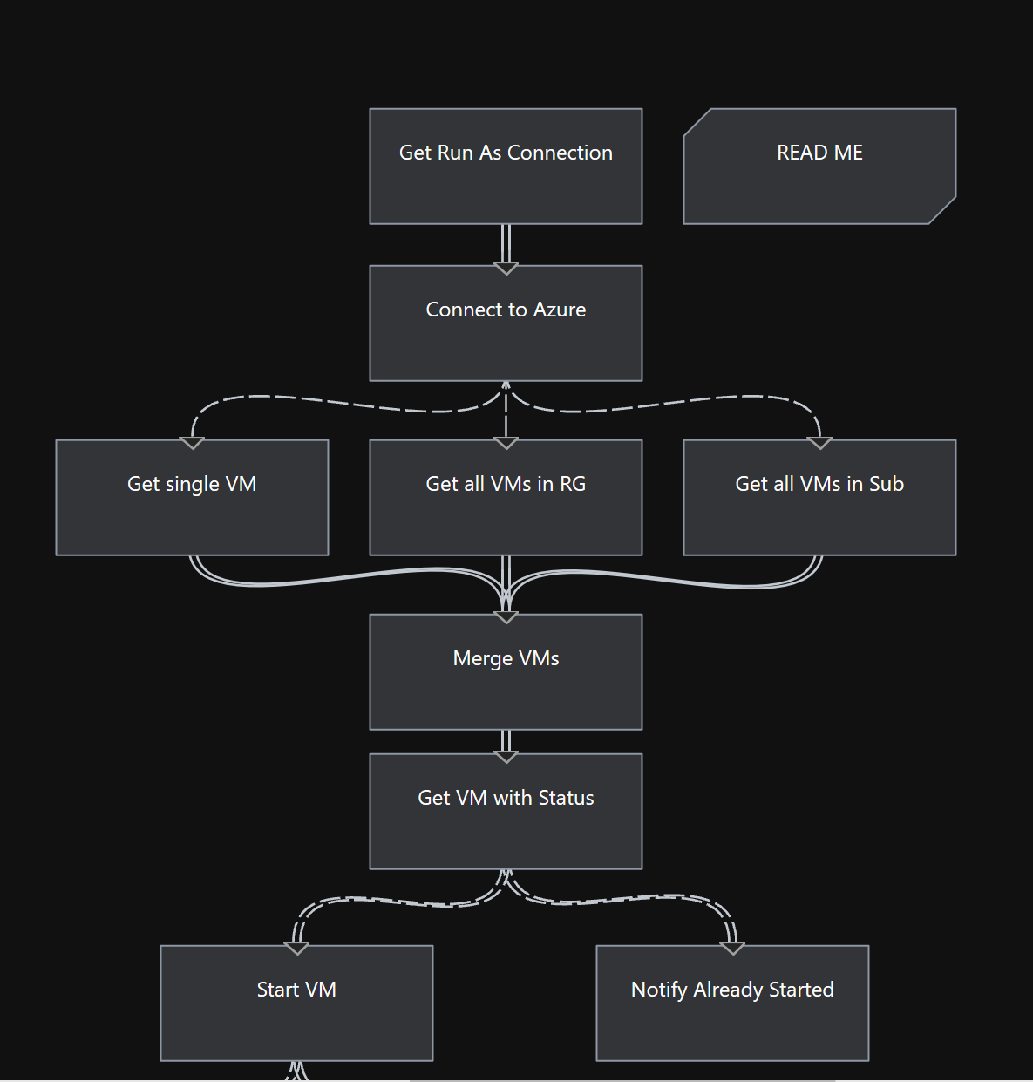
Graphical Runbooks

Slide 11
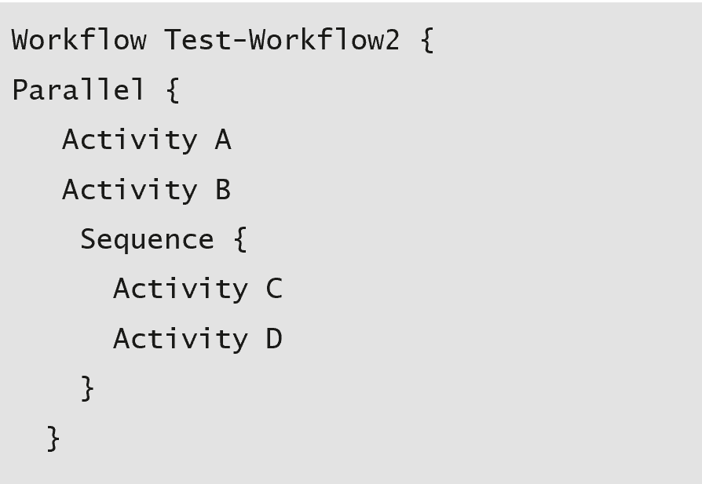
PowerShell Workflows

Slide 12
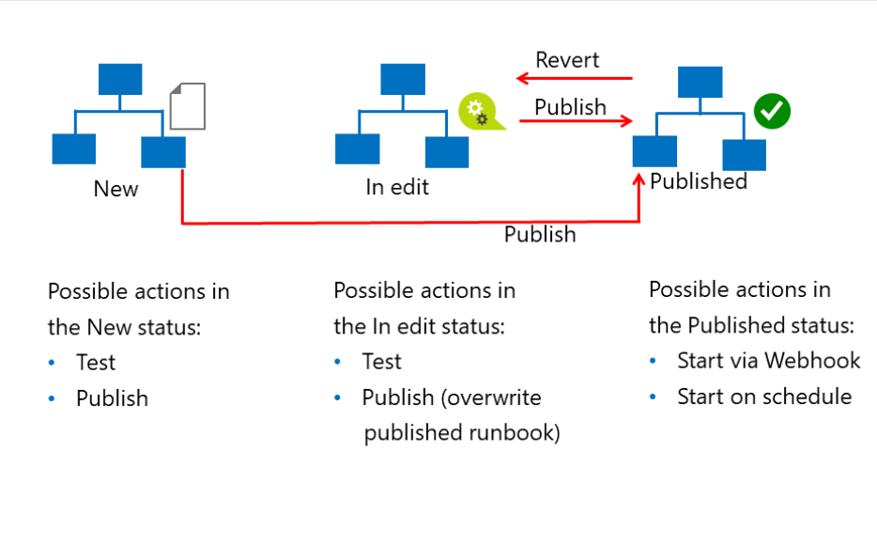
Runbook Lifecycle

Slide 13
DEMO: Azure Runbooks
Notes:
Portal
Powershell / CLI

Slide 14
Lab 5.2 Azure Runbooks
Notes:
Portal
Powershell / CLI

Slide 15
Fragen?

